Slide 1
Terminology Governance and Publishing at HL7
Unified Terminology Governance (UTG)
Jessica Bota, UTG Project Manager

Slide 2
UTG Topics for HL7 Members
The HL7 Terminology website (https://terminology.hl7.org)
Web page layout
Published versions and current (latest in development)
Documentation and Terminology Artifacts
Content downloads
Published Terminology Artifacts
Code Systems, Value Sets, Concept Maps and Naming Systems (tabs)
HL7 product family organization (subtabs)
UTG Vocabulary model

Slide 3
UTG Topics for HL7 Members
The UTG process
Key highlights
In-scope/out-of-scope terminology
External (non-HL7 terminologies)
The UTG Jira workflow for HL7 members
Accessing and reviewing Vocabulary issues and content needs queue
Reviewing Vocabulary change proposals in process
Reporting content needs and issues
Notes:
Need to talk to Peter Jordan about downloads

Slide 4
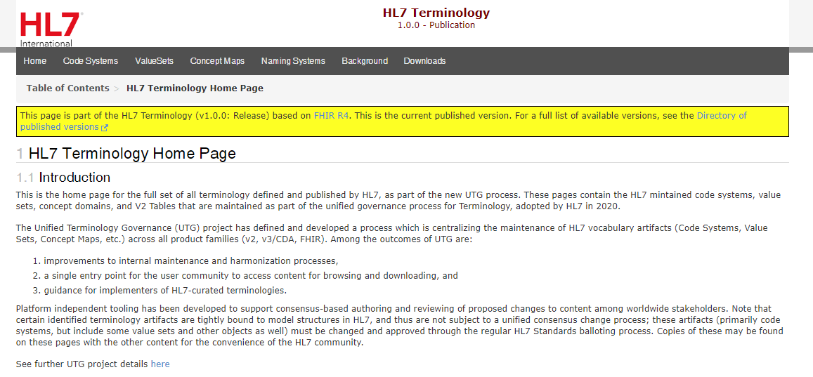
The HL7 Terminology Website
The HL7 Terminology website is free to browse at https://terminology.hl7.org/

Slide 5
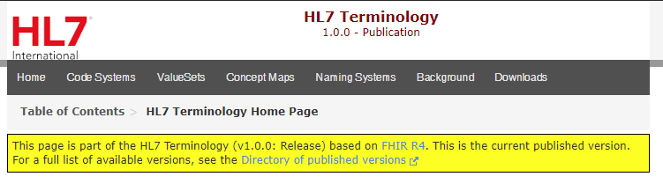
HL7 Terminology Versions
The HL7 Terminology website at https://terminology.hl7.org/ points to the latest published release of HL7 content
The version of the publication is always listed at the top of the pages
Previous published versions and the current version (latest in development) also accessible via ‘Directory of published versions’

Slide 6
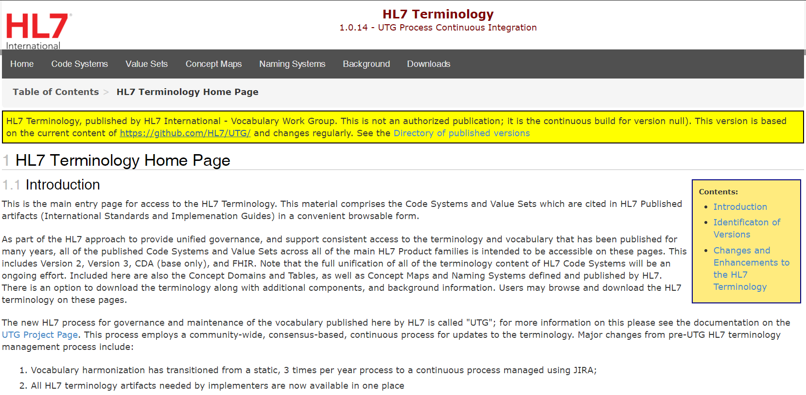
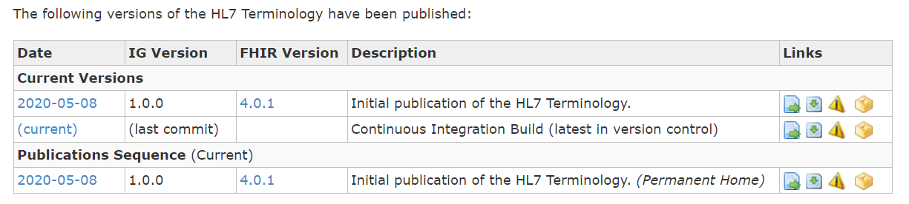
HL7 Terminology Versions
All published versions are listed in the ‘Directory of published versions’
Links exist to download or browse versions of content (more on this later)

Slide 7
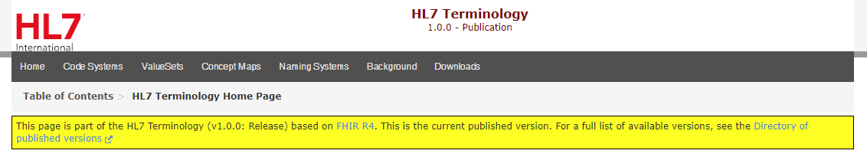
Terminology Content and Documentation
Documentation available directly on the Terminology pages
Home Page
Introduces the Unified Terminology Governance process
Describes the content layout
Describes UTG versioning approach
Background
Outlines common architecture of HL7 content in UTG
Describes types of artifacts
Additional information available on Terminology Artifacts tabs and grouping subtabs

Slide 8
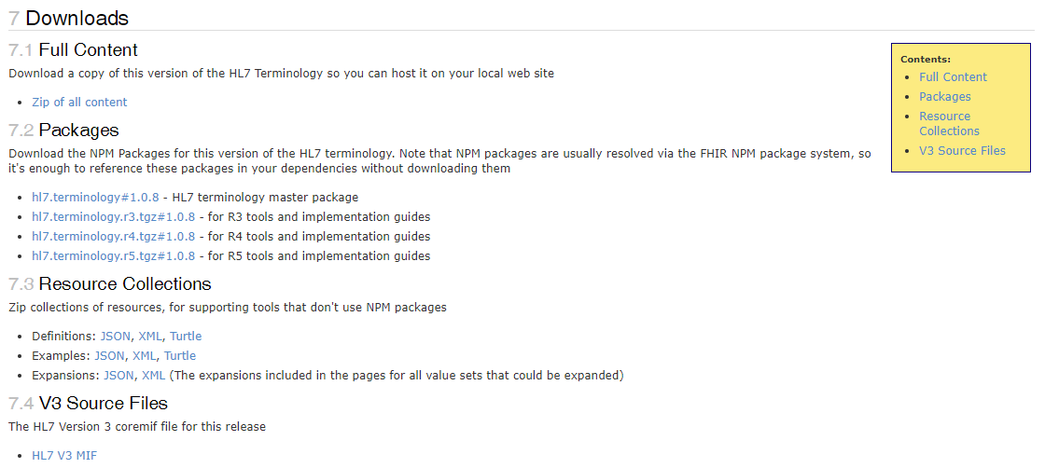
Content Downloads
Ensure that you are on the pages for the version of the terminology that you want to download
Several download formats available on the ‘Downloads’ tab
Full content
NPM packages
Resource collections
V3 Source Files

Slide 9
Terminology Artifacts
Code Systems and Value Sets – HL7 terminology is now represented in FHIR Code System resources and Value Set resources that have extensions to support the other HL7 product family differences in terminology design
Design of Value Sets conforms to the Characteristics of a Formal Value Set Definition Normative Standard
Naming Systems – handy machine-processable reference of the current and former identifiers for Code Systems or Identifier System
Concept Maps – statements of relationships from one set of Concepts to one or more other Concepts, not currently published here

Slide 10
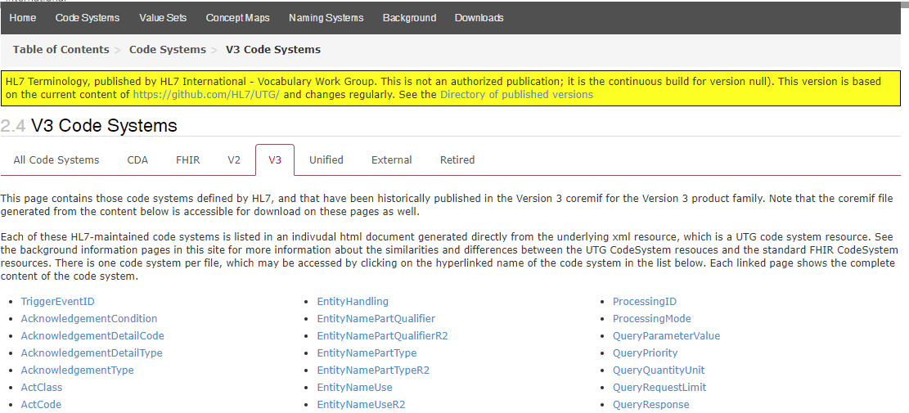
Terminology Artifacts
Terminology artifacts are organized by type (i.e. Code System) and then useful groupings (i.e. V3)

Slide 11
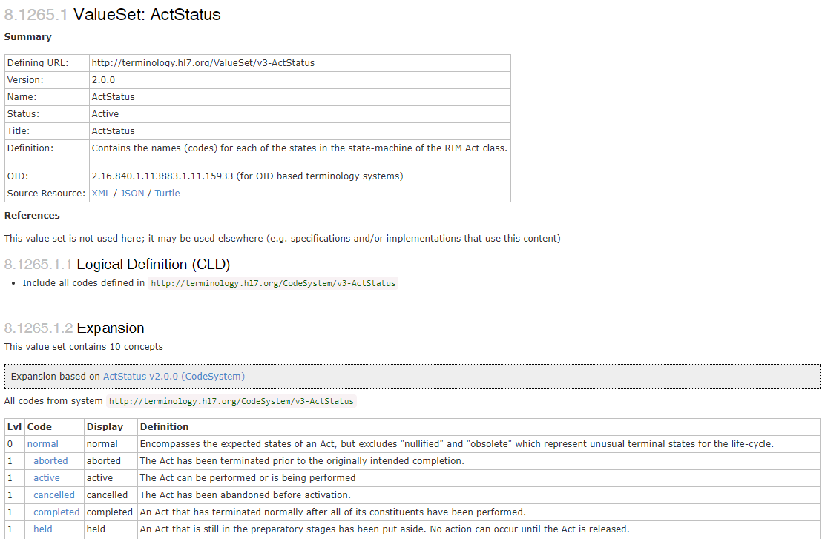
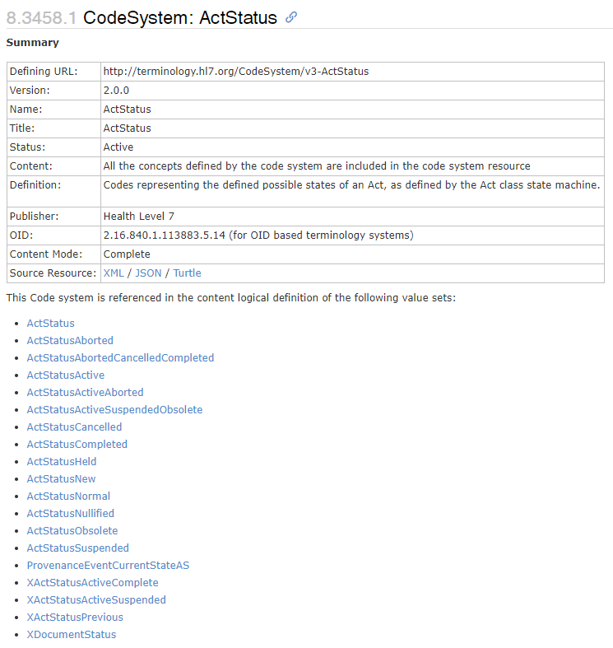
Artifact Summary Display
The Summary provides
Artifact metadata
Source files (XML/JSON/Turtle)
Links to other artifacts referenced by the selected artifact
Code Systems list Value Sets that are cited on this site
Value Sets list Code Systems that they include content from

Slide 12
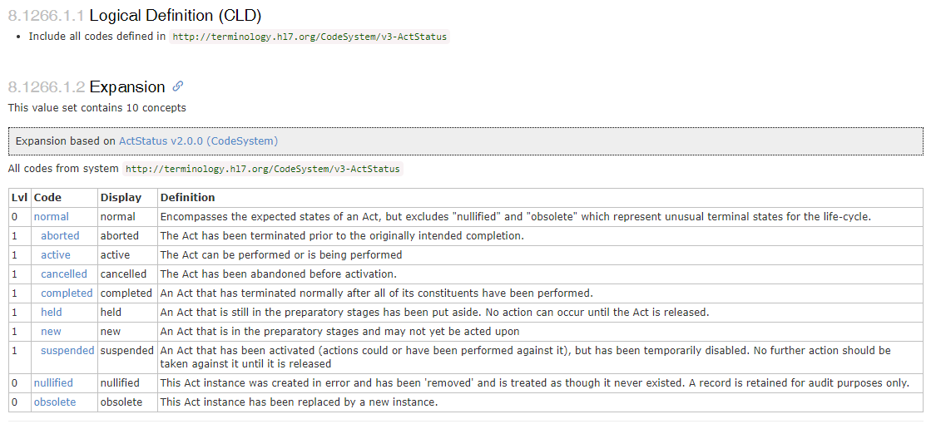
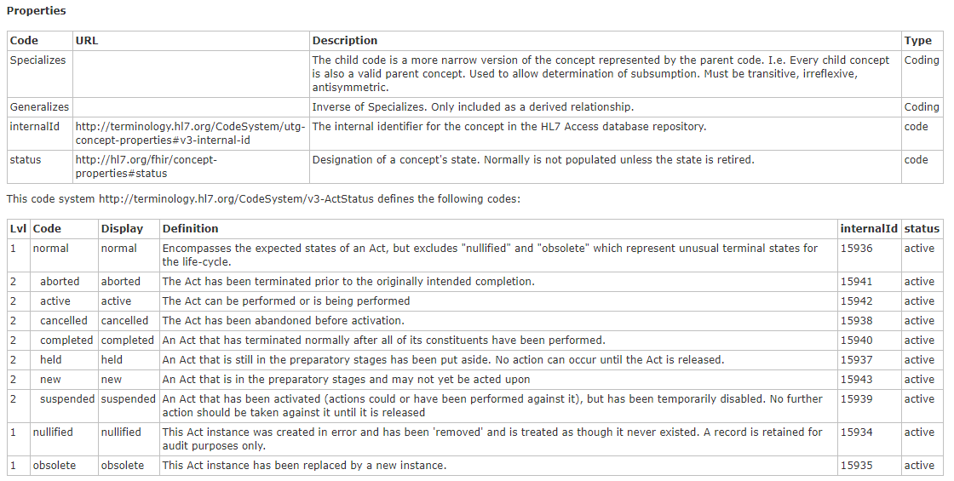
Artifact Content

Slide 13
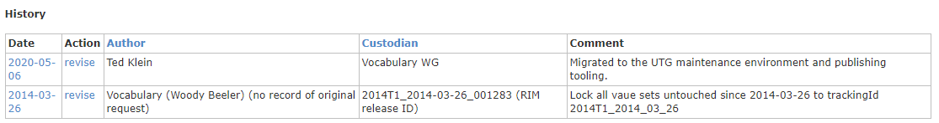
Artifact History Tracking
History tracking information is updated when modifications to the artifact are made

Slide 14
Scope of Terminology Artifacts
In scope
Everything rooted (has canonical uri) in http://terminology.hl7.org
External content identifier sets that are managed in UTG
CDA Base is a subset of V3 content
Out of scope
Value Sets and Code Systems which are "ballot bound“ and continue to be managed through the traditional ballot processes
V2, V3, FHIR, C-CDA
Implementation Guide-specific Code System and Value Sets

Slide 15
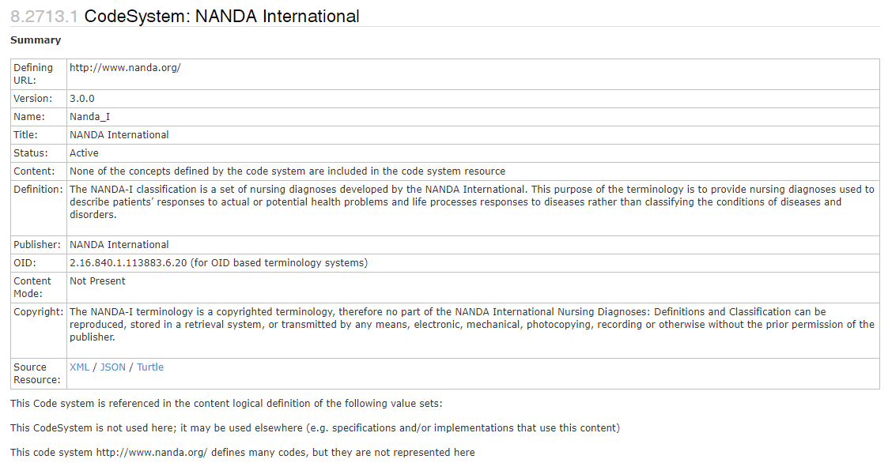
External (non-HL7) Terminologies
UTG CodeSystem resources for content that is curated and published by others outside of HL7
Most contain no coded content
Full content is available from the listed publisher
Identifiers (OIDs, URIs, etc.) used in the different product families are published here
There are some Code Systems that HL7 has negotiated with the publisher to redistribute a subset of their content through UTG
Notes:
Like SNODENT
Historical and superseded identifiers are captured in UTG Naming Systems, right now just external terminologies. If ever internal, will create NS.
NS is where we capture the CS/VS identifier lineage, most only one.

Slide 16
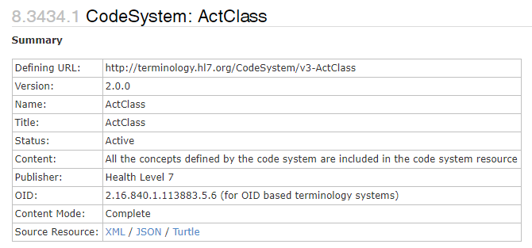
Versioning of the HL7 Terminology
The HL7 Terminology carries a 3-part release version identifier
The published release, current build, and each individual terminology artifact
Version identifier format is Major.Minor.Patch
Published releases generated as needed
Major version number is incremented when generated
The current build carries a version indicating its lineage from the last published
Patch version number incremented one or more change proposals are approved and a new build is generated
Each individual terminology artifact has its own version identifier
Updated according to the Vocabulary Work Group Versioning Policy
Notes:
Get script from build pages
Just mention small details about major, minor, patch, rest in submitter tutorial
Certain events may trigger release – new ballot to respond to regulated changes that have code systems, might just be time too

Slide 17
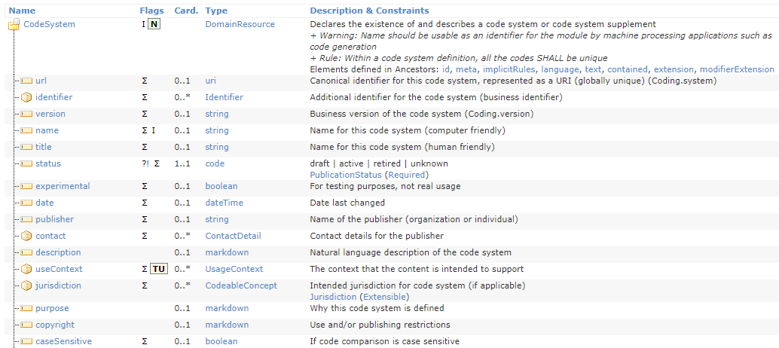
UTG Model
The UTG model aligns with the FHIR Code System and Value Set normative resources, and the FHIR Naming System resource including several extensions to support misalignment between normative FHIR and Version 2 and Version 3 terminology
Internal system support for some of this is in a UTG Maintenance Infrastructure Code System

Slide 18
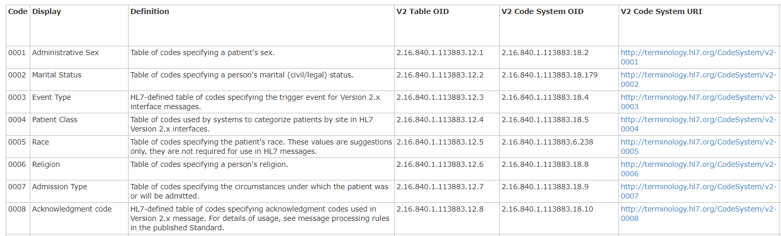
Representation of HL7 Version 2 Tables
The V2 underlying Code Systems and Value Sets are in UTG as published in the V2.9 normative standard
The Tables are represented in a ‘V2 Tables’ Code System
One concept for each V2 Table
An extensive set of Concept Properties holding all table metadata

Slide 19
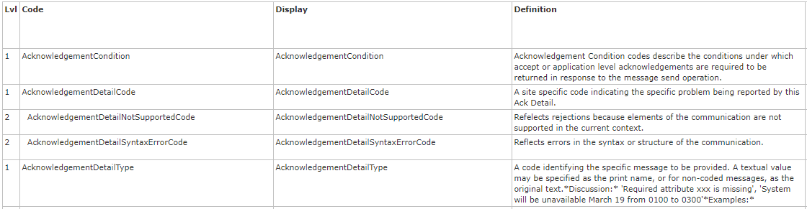
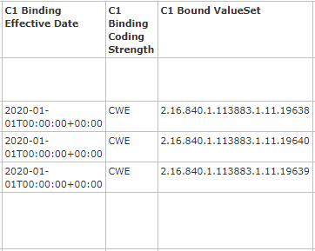
Representation of HL7 Version 3
All Code Systems and Value Sets published in the V3 Coremif have been imported to UTG,
Extensions and properties for the differences in the vocabulary models
Concept Domains from the V3 Coremif are now in a single Code System
The bindings are concept properties in the Concept Domain Code System

Slide 20
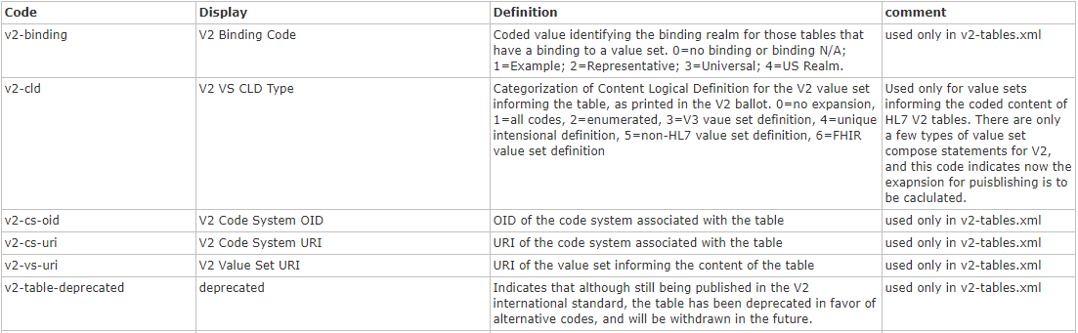
Infrastructure Vocabulary
Includes the Concept Properties Code System and the Maintenance Infrastructure Code System, which are part of the unified set of Code Systems
These help support both the representation of V2 and V3 in the FHIR model and internal UTG workflow maintenance operations

Slide 21
Unified Terminology governance at HL7

Slide 22
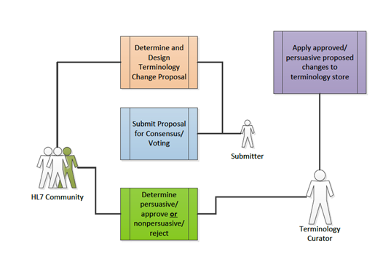
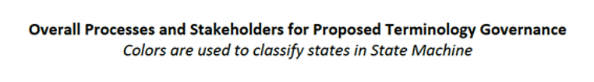
Unified Terminology Governance Process
All HL7 terminology artifacts are maintained using a single process
Vocabulary harmonization is now a continuous process (instead of three times a year)
Dedicated Jira project
Platform independent tooling to create proposed terminology changes
Consensus-based proposals review process (in Jira)
Change control using Git and Svn
All artifacts are versioned and managed independently
Notes:
Red oval around middle three boxes and say it is managed in the jira workflow. Submitter and review has entire sessions dedicates.

Slide 23
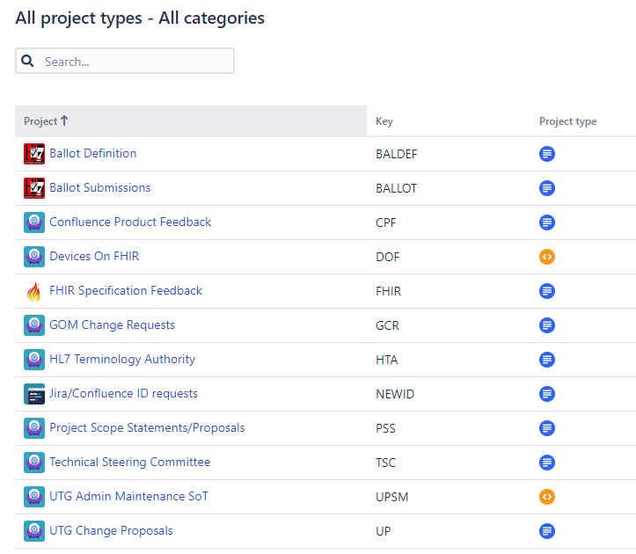
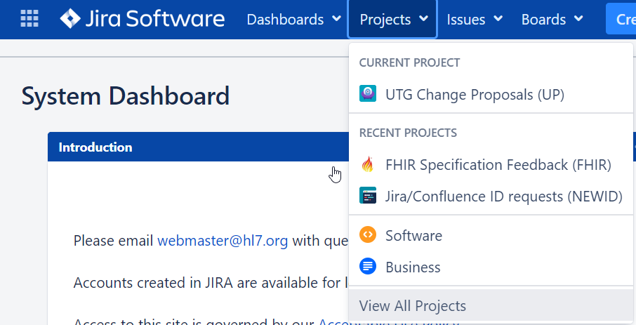
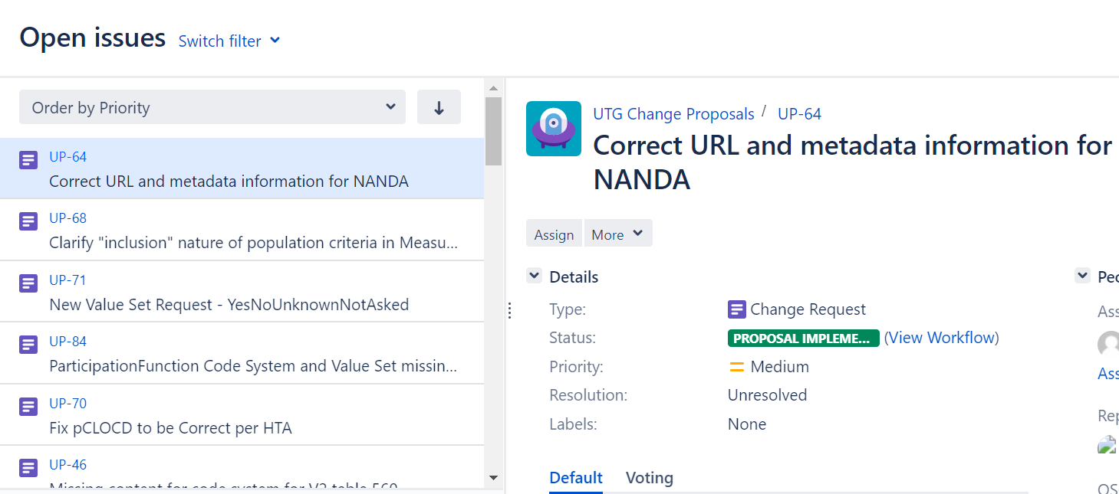
UTG Change Proposal (UP) Jira Project
The only requirement to access the project is an HL7 Jira login for https://jira.hl7.org
Jira ‘Help & Documentation’ available off of the main HL7 Confluence page
Default view is ‘Open Issues’

Slide 24
Types of UTG Jira Tickets
Identified Content Issues
These identify vocabulary problems but no suggested solution has been identified
These tickets will not move forward to an implemented solution until someone creates a vocabulary change proposal for the solution
Identified content issues are in the ‘Waiting For Input’ state
Vocabulary Change Proposals
These tickets contain the proposed content changes
The content changes are rendered in context for review
Submitted vocabulary proposals are in the ‘Consensus Review’ state

Slide 25
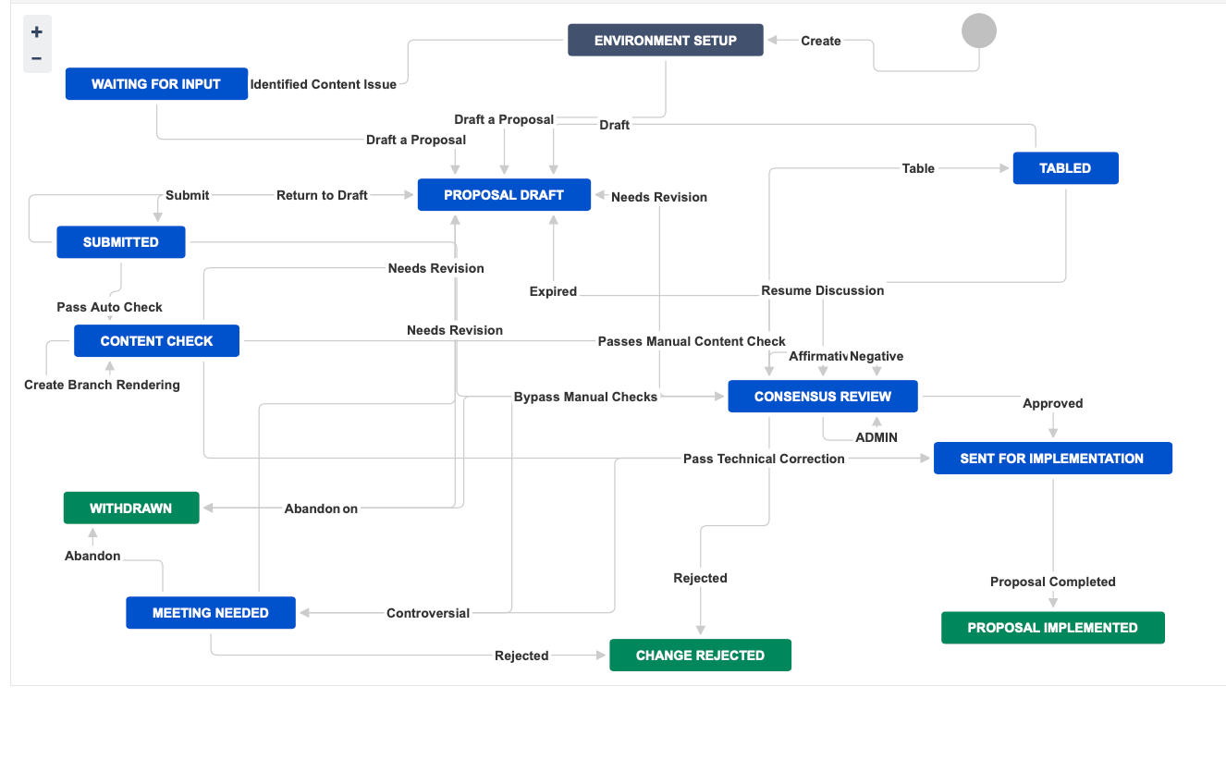
UTG Jira Workflow

Slide 26
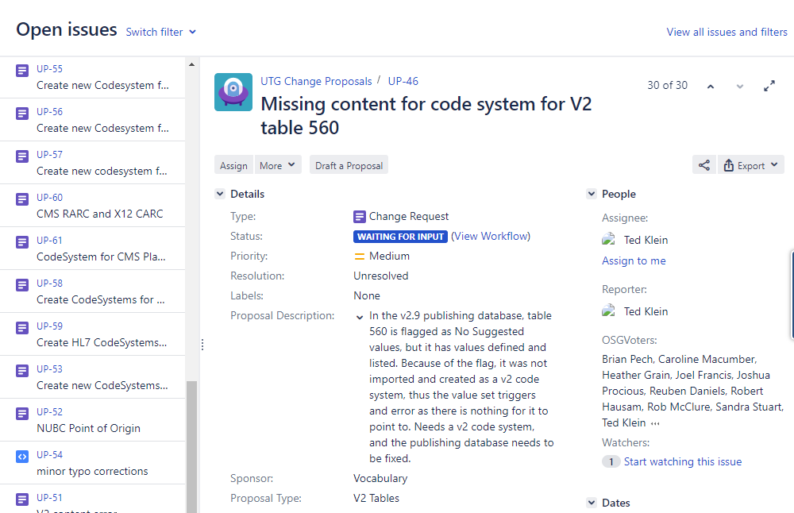
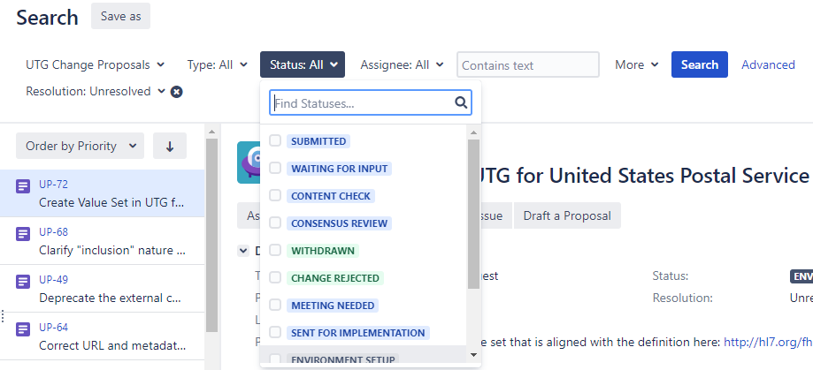
Searching Through UTG Jira Tickets

Slide 27
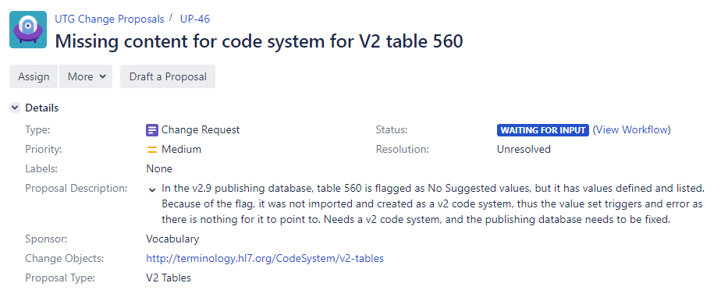
Content Issues Queue
The content issues queue keeps track of vocabulary issues and needs
These tickets provide a description of the issue/need but do not provide the solution
Anyone can design a solution to the issue and draft a Vocabulary Change Proposal
Notes:
So we don’t forget about content issues. Really just a list of to dos. NEED SOLUTION*** as part of ticket to move it forward. Search here
List pieces of information

Slide 28
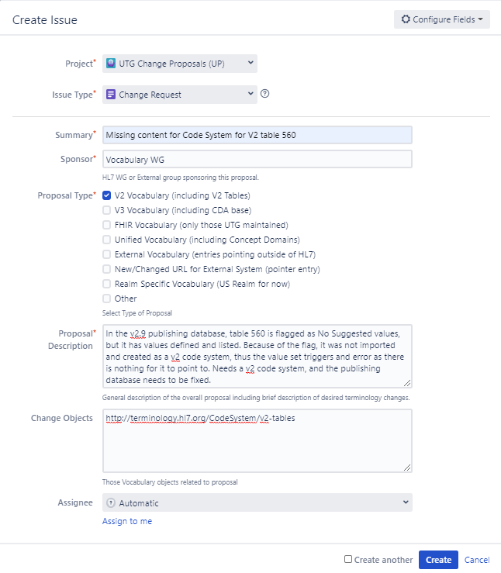
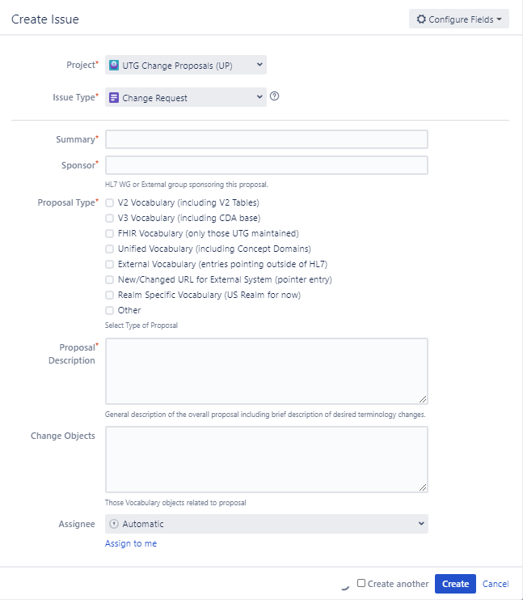
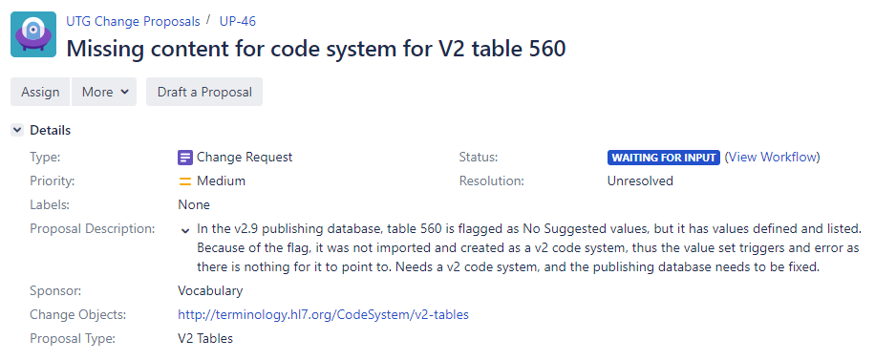

Reporting a Content Issue
HL7 members can report content issues or needs
Ensure no duplicate tickets exist
Enter information regarding the issue/need
Ticket will only move forward if a Vocabulary change proposal is drafted
Notes:
Just so it doesn’t get forgotten. FIRST check if issue has already been reported

Slide 29
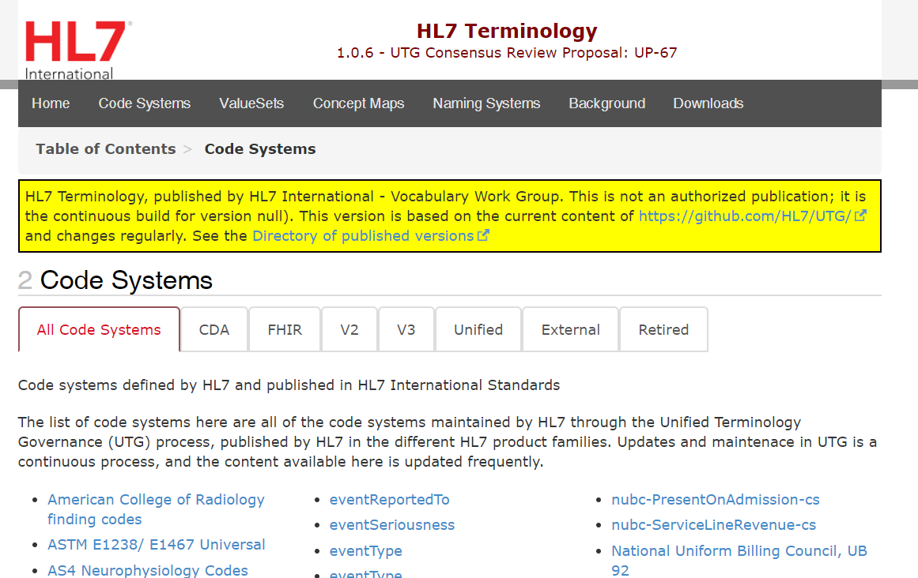
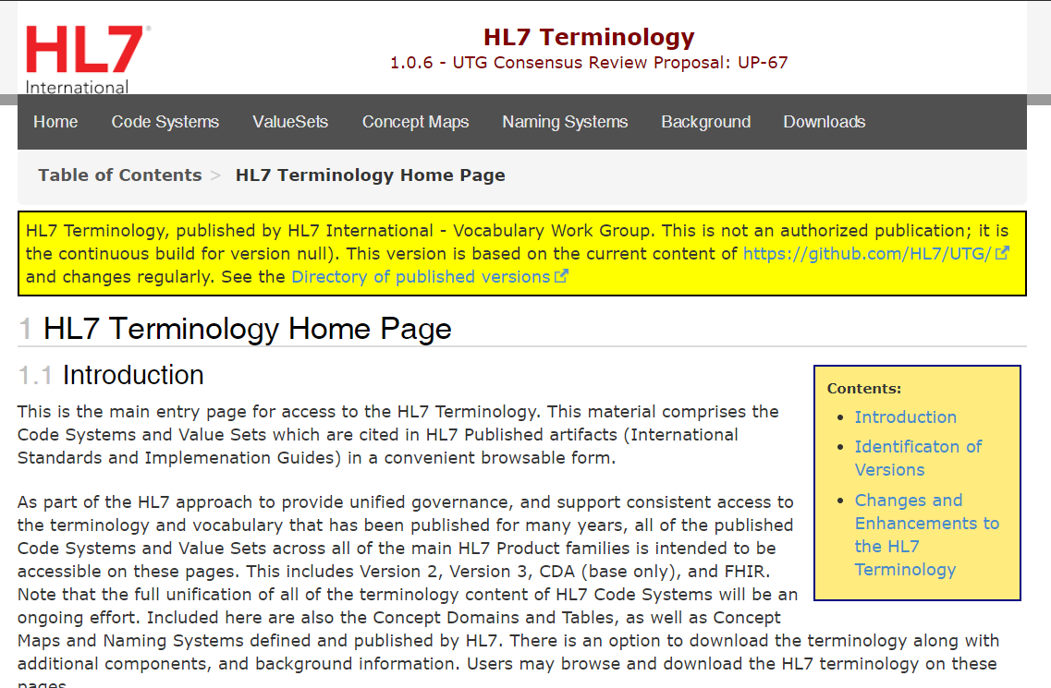
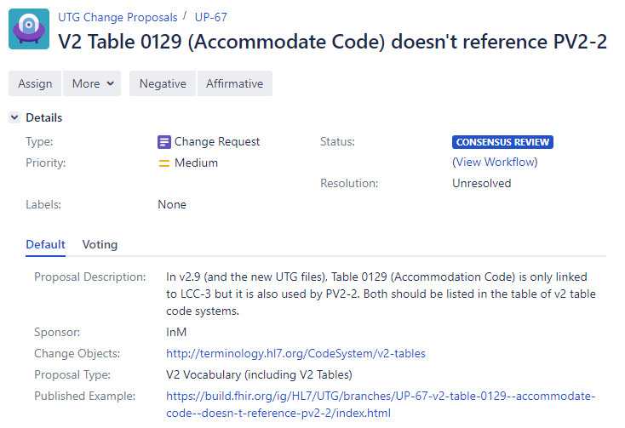
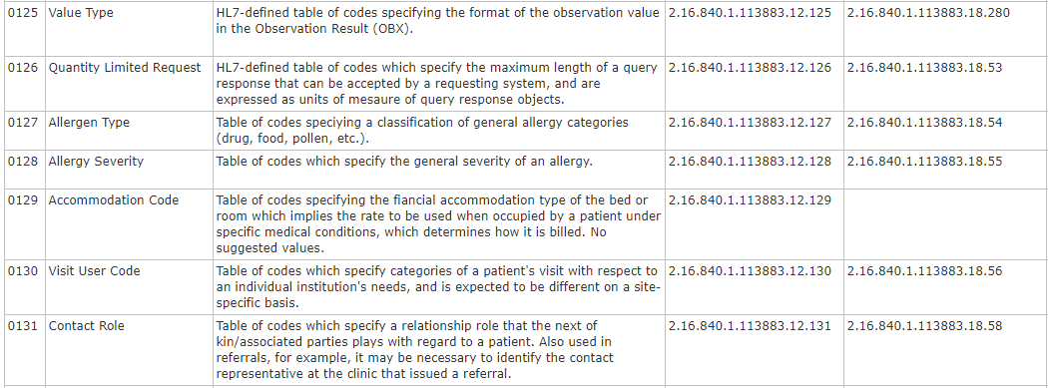
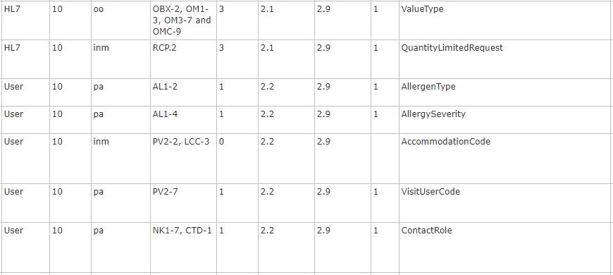
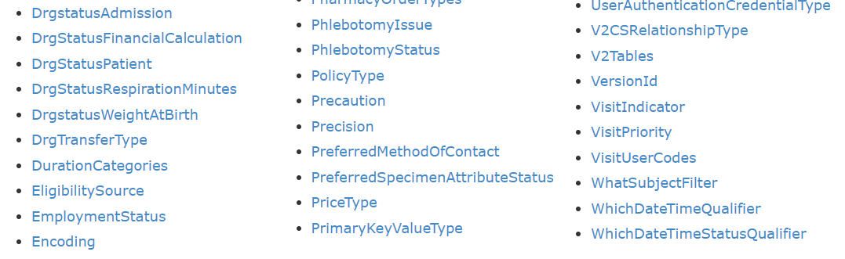
In-Flight Vocabulary Change Proposals
Change proposal queue contains fully specified changes to address content issues or new needs
Submitters have special Jira permissions and are familiar with the tooling and processes
Proposals are made available for review, suggestion, and approval/rejection
Curator processes to Consensus Review
Reviewers only need a browser to see the designed change(s)
Upon approval, changes are scheduled for implementation in the UTG current content
Notes:
Gets technical view and oversight and browseable view of the changes, done by curator, then goes to CR where it either gets approved or rejected or contentious where it may need a meeting to resolve or it might expire if it is around too long and go back to draft state, or submitter can pull back and revise and resubmit (list these five options on next slide)
Each have unique id, different states
TC can push to needsRevision – done by consensus, only pushed back if technical issue during content check
Once in CR – fate is in the hands of the community, all state transitions dependent on community
Responsiveness in the hands of the community, not calendar

Slide 30
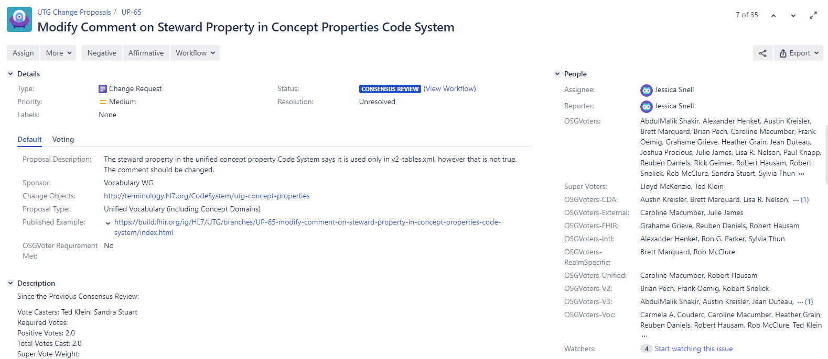
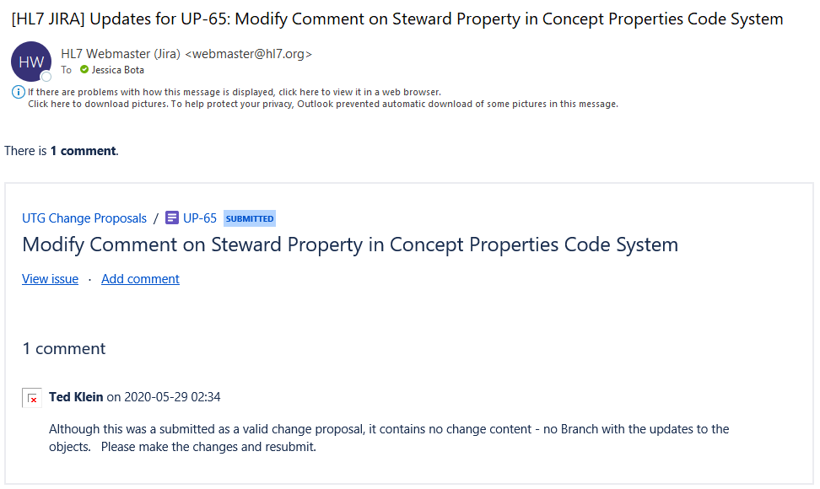
Watching a Ticket

Slide 31
Change Proposals Outcomes
Consensus Review possible outcomes
Change proposal is approved
Designed changes are implemented in the current build of HL7 Terminology
Changes are released and watchers are notified
Change proposal is rejected
Ticket is archived for future audit
Watchers are notified that changes will not be implemented
A change proposal may alternatively be revised and resubmitted or withdrawn

Slide 32
Governance of HL7 Terminology Summary
Changes can be requested and processed as needed, not driven by calendar
Change proposals are in your hands and on your schedule
Changes will be processed at the speed at which people participate
Can happen in a matter of days
Documentation and tooling available on HL7 Confluence page
Specialized sessions will be made available with the following topics
Reviewing and Voting on Proposed Vocabulary Changes
Submitting Vocabulary Proposals

